Slide 1
When Will Fossil Fuels Run Out?
Joe Brown, Derek Markey, Joseph Sharp

Slide 2
Presentation Overview
What are Fossil Fuels
Data Source and Disclaimer
Primary Energy Consumption
When Will Oil Run Out?
When Will Natural Gas Run Out?
When Will Coal Run Out?
What Will Replace Fossil Fuels and When?

Slide 3
What Are Fossil Fuels
Given the right conditions dead plant matter and aquatic phytoplankton and zooplankton forms hydrocarbons with a process that takes millions of years
The energy in Fossil Fuels originated from ancient photosynthesis
Main Types of Fossil Fuels
Coal
Petroleum
Natural Gas
https://en.wikipedia.org/wiki/Fossil_fuel

Slide 4
Data Source
BP Global Statistical Review of World Energy
World wide Information on Fossil Fuel Reserves as well as production and consumption of major Energy Sources
Last updated in 2017
Provides Historical records of Energy Reserves, production, and consumption
https://www.bp.com/en/global/corporate/energy-economics/statistical-review-of-world-energy.html

Slide 5
Disclaimer
The Models created do not account for Climate Change (Global Warming) and any Regulations that might be put in place to slow the production of Green House Gases
For Example, According to the UN's Intergovernmental Panel on Climate Change:
Fossil fuels, including petroleum, need to be phased out by the end of 21st century to avoid "severe, pervasive, and irreversible impacts for people and ecosystems*
We are assuming Fossil Fuels will be used until Reserves are Depleted, using historic use to predict future use
*Intergovernmental Panel on Climate Change. "Climate Change 2014 Synthesis Report." p. 56

Slide 6
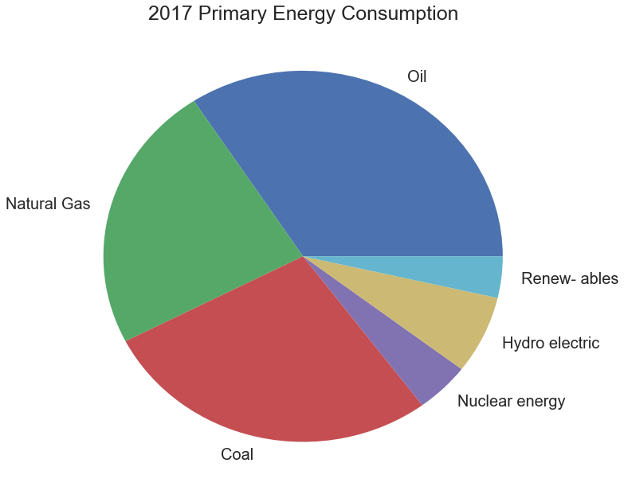
Primary Energy Consumption (2017)
Over 85% of the World’s Energy Came from Fossil Fuels in 2017
Non Fossil Fuel Sources account for less than 15% of the World’s Energy

Slide 7

Petroleum (Oil)
When Refined Yields a multitude of different Fuels as well as Several Consumer Products
A common Fuel derived from Petroleum is Gasoline
Products such as Plastics, Pesticides, and Pharmaceuticals also are derived from Petroleum
Notes on Petroleum Reserves
Reserves are based on what is economically feasible to extract. Therefore, as technologies for extracting oil, and the demand for oil increase, Reserves also Increase
https://en.wikipedia.org/wiki/Petroleum

Slide 8
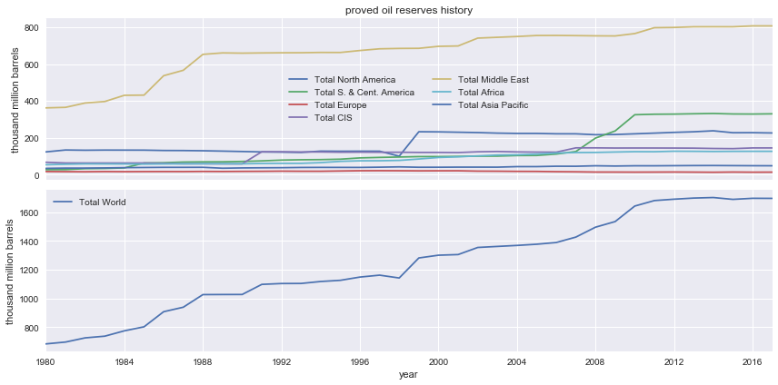
Proven Oil Reserves
Notes:
CIS : Commonwealth of Independent States (Former Soviet Union in Eurasia)
US is top blue line

Slide 9
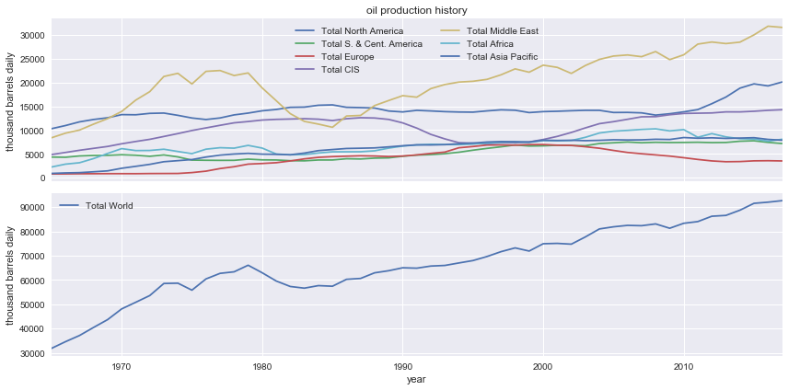
Production of Oil
Notes:
US is top blue line

Slide 10
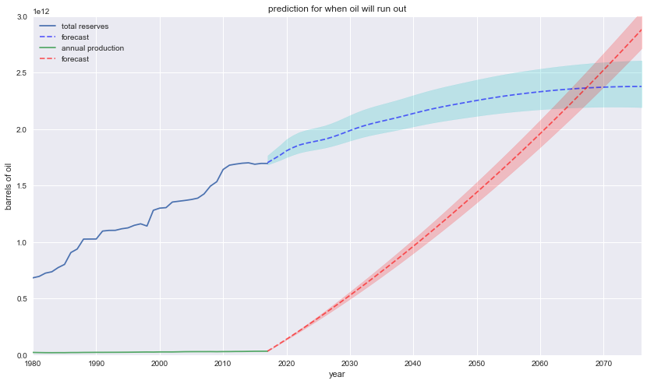
Predictions For Oil
Forecasted Reserves
Barrels of Oil in Trillions
Cumulative sum of forecasted production
Historic Data
Notes:
The red dotted line is the cumulative sum of barrels produced starting at 2018
(Not just the forecast of oil Production)
Predictions were calculated using arima

Slide 11
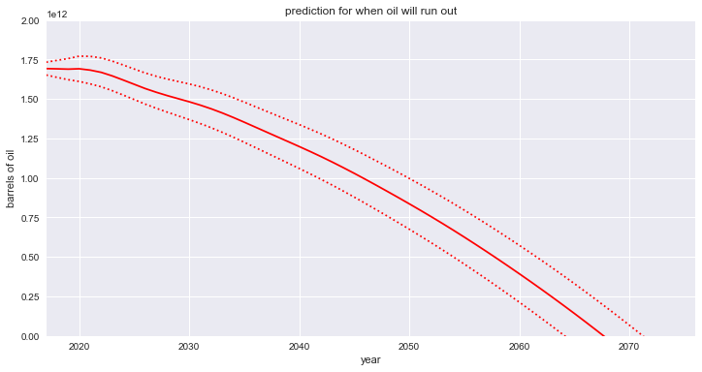
Prediction of When Oil Will Run Out
Barrels of Oil in Trillions
Notes:
Predicted Reserves – Cumulative Sum of Predicted Produced Oil

Slide 12
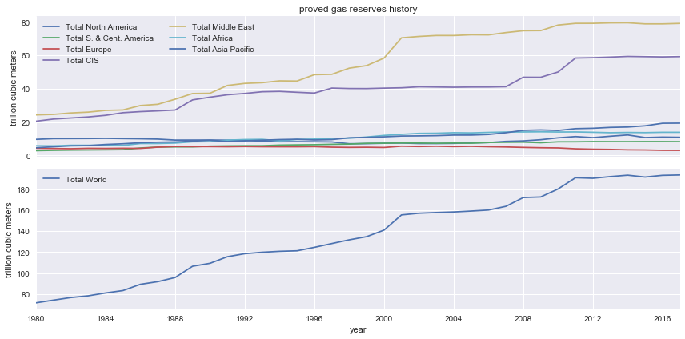
Natural Gas Reserves

Slide 13
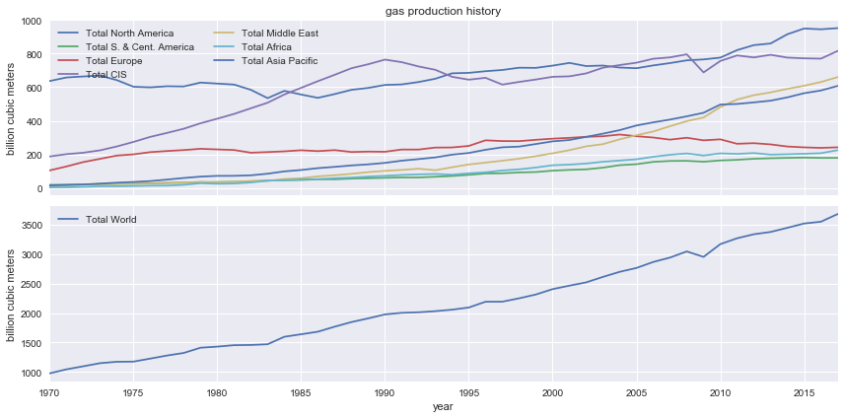
Production of Natural Gas
Notes:
US is top blue line

Slide 14
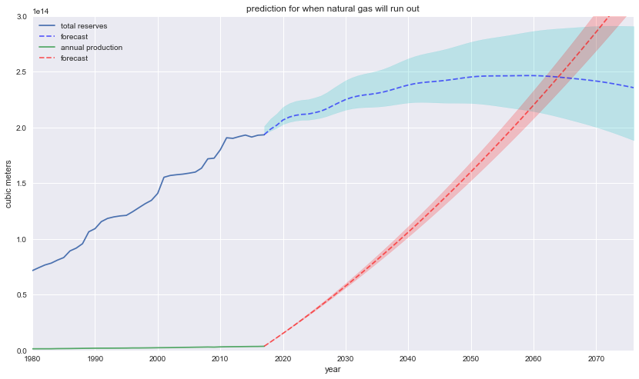
Predictions For Natural Gas
Forecasted Reserves
Hundred Trillion Cubic Meters
Cumulative sum of forecasted production
Year

Slide 15
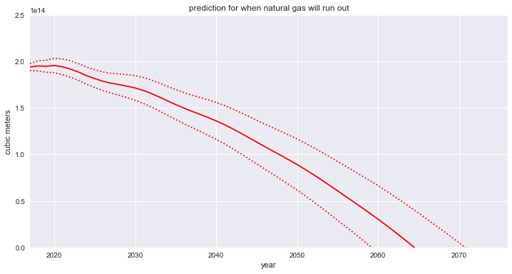
Prediction of When Natural Gas will Run Out
Hundred Trillion Cubic Meters

Slide 16
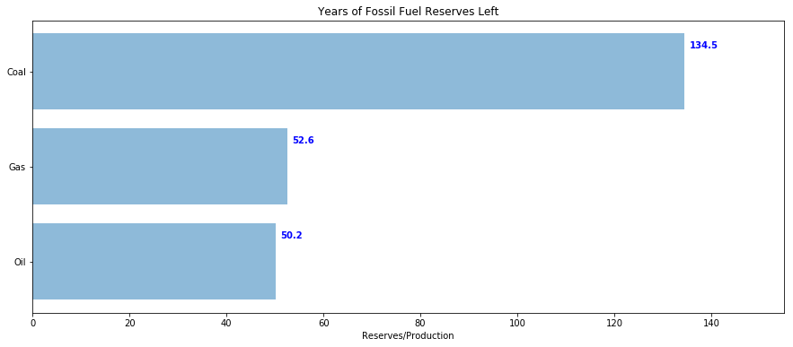
Reserves / Production (2017)
2151
2069
2067
Based on the Reserves and Production Rate in 2017
Notes:
Blue Numbers: How many years are Left
Black Numbers: Which year will it run out

Slide 17


Renewable Energy
Energy that is Naturally Replenished on the Human Time-scale
Example Sources of Renewable Energy
Wind, Solar, Tides, Waves, Geothermal Heat, Hydroelectricity

Slide 18
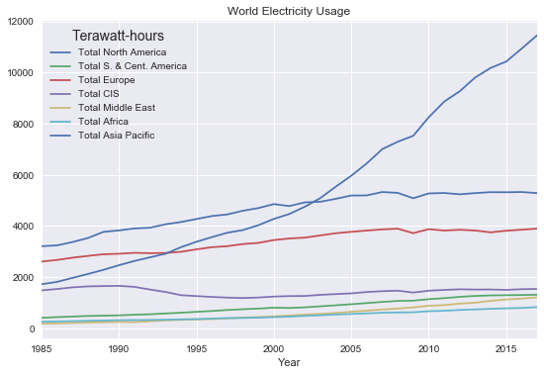
World Usage of Electricity
Notes:
Asia is top blue line

Slide 19
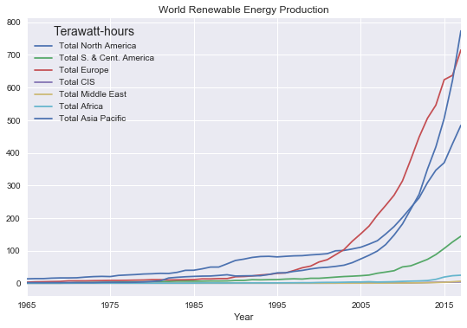
World Production of Renewable Energy
Notes:
Asia is top blue line

Slide 20
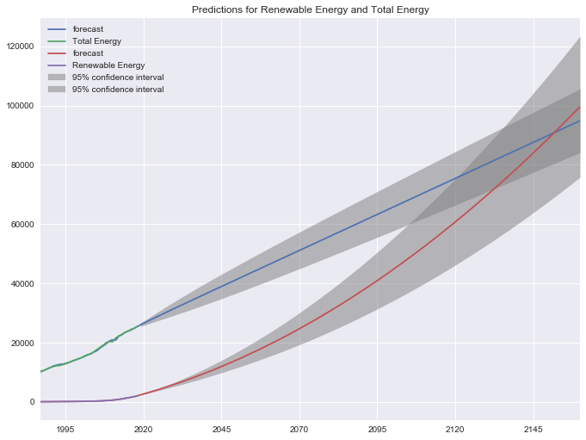
Predictions for Renewable Energy and Total Energy
World’s Projected Total Energy Demand
Terawatt Hours
Projected Growth in Renewable Energy
Year

Slide 21
Conclusion
Even if we do not slow or stop our Fossil Fuel Consumption because of Environmental Reasons. We will Deplete our Fossil Fuel Reserves and be unable to use Fossil Fuels for Energy. According to our Models, Oil and Natural Gas will be Depleted in the next Hundred Years. One way to fill the gap is Renewable Energy Which will have to Increase Exponentially to Meet the World’s Projected Energy Demand by 2150. (Not Considering Environmental Impacts)

